Slide 1
Unit Testing and Functional Testing
By Renugopal Sivaprakasam

Slide 2
01
02
Introduction
Unit Testing
03
04
Functional Testing
Tools and Best Practices

Slide 3

Why Testing is needed ?
The Knight Capital Group had a software glitch that accidentally sold all the stocks it bought.
It lost $440M in just 45 minutes
Knight Capital Says Trading Glitch Cost It $440 Million [1]
Notes:
his occurred because a newly deployed trading software update had an old, unused piece of code that was accidentally activated, causing the system to execute a massive number of unintended trades. The errors, which included rapid buy and sell orders in over a hundred stocks, resulted in the firm taking large, unintended positions that were later liquidated at a significant loss.

Slide 4
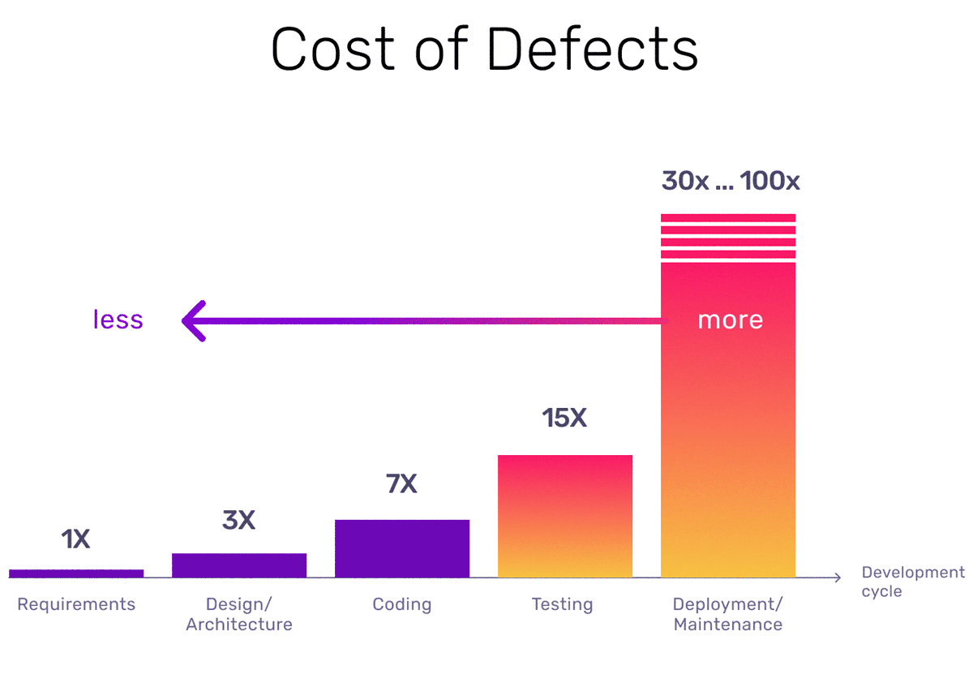
[2] Cost of Defects

Slide 5

Why Test at All?
Catches defects early in the development cycle
Ensures code quality, reliability, and maintainability
Regulatory requirements
Faster feedback loops (CI)
Types: Unit, Integration, Functional, and more
Notes:
Solid tests → fearless refactors → faster features → happier users.
Finance/healthcare audits ask for test evidence by default.

Slide 6

Unit Testing
def divide(numerator: float, denominator: float) -> float:
"""
Divide two numbers and return the quotient.
"""
return numerator / denominator
def test_divide_integer_result():
"""10 ÷ 2 → 5"""
assert divide(10, 2) == 5
The assert keyword lets you test if a condition in your code returns True, if not, the program will raise an AssertionError.

Slide 7
Unit Testing
def test_divide_non_int_result():
"""7 ÷ 2 → 3.5 (decimal result)"""
assert divide(7, 2) == 3.5
def test_divide_negative_dividend():
"""-9 ÷ 3 → -3"""
assert divide(-9, 3) == -3
def test_divide_zero_numerator():
"""0 ÷ 5 → 0"""
assert divide(0, 5) == 0
# ---------- error scenario ----------
def test_divide_by_zero_raises():
"""Any ÷ 0 should raise
ZeroDivisionError"""
with pytest.raises(ZeroDivisionError):
divide(42, 0)

Slide 8
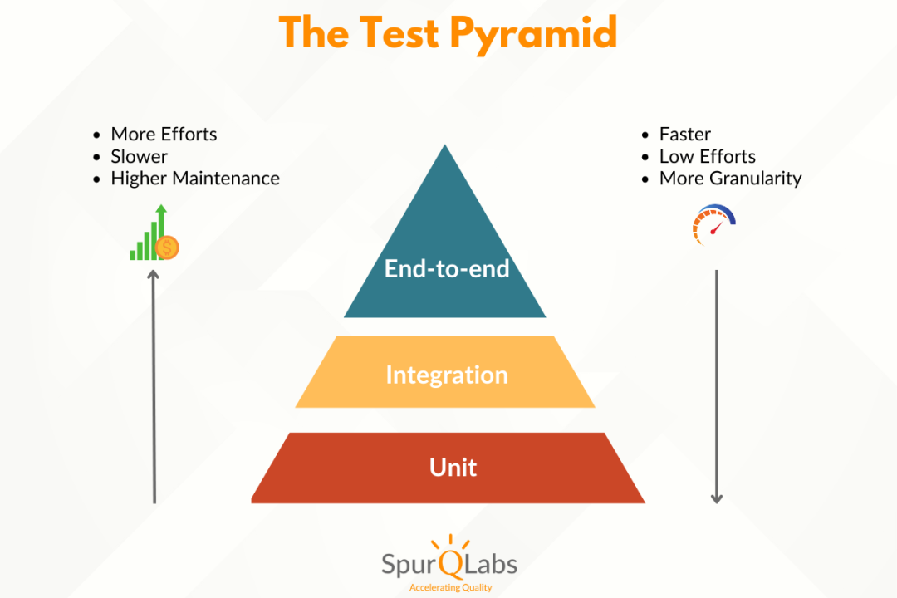
Unit Testing
Smallest testable piece (function/class) == unit
Runs in isolation (no DB, FS, network)
Fast (≤ 10 ms ideal)
White-box orientation (knows internals)
Notes:
When a block of code requires other parts of the system to run, you can’t use a unit test with that external data. The unit test needs to run in isolation.

Slide 9

Functional (System/Integration) Testing
Validate user-visible behavior & business flows
Treat system as black box (UI → DB → API)
Slower
Detect integration issues/config drift

Slide 10

Functional Testing
# Selenium + pytest
def test_guest_can_add_item_to_cart(browser):
browser.get("https://shop.example.com")
browser.find_element(By.ID, "Buy").click()
assert "Cart (1)" in browser.page_source
Launches Chrome, exercises full stack
Asserts business outcome, not internal implementation

Slide 11
Unit vs Functional Test
 | Unit Testing | Functional Testing
Scope | Single function | Whole workflow
Speed | ms | s - min
Frequency in CI | Every push | Daily/nightly
Tool examples | pytest, JUnit | Selenium, Cypress

Slide 12
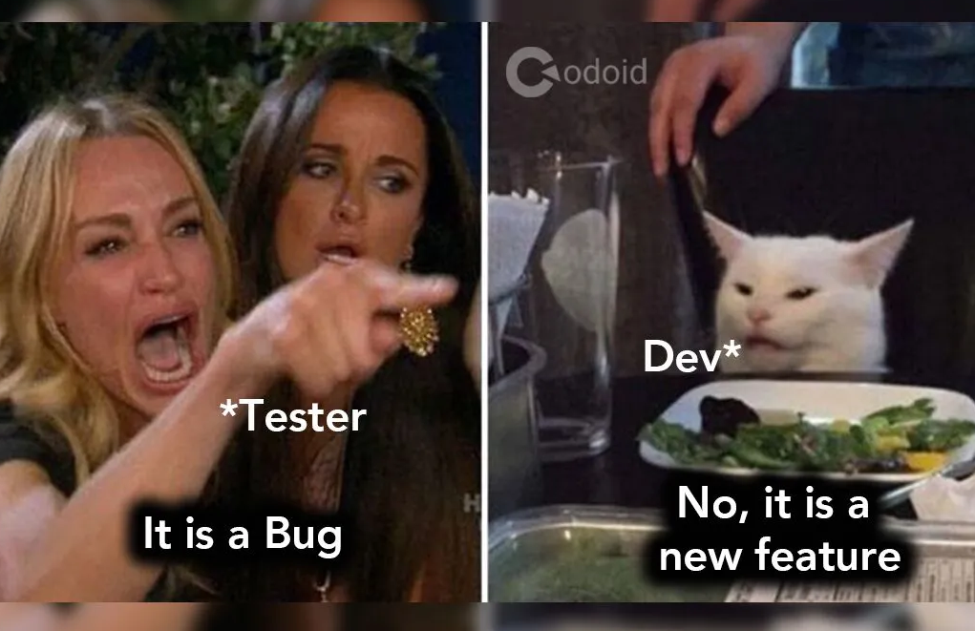
Unit Testing Best Practices
Define clear acceptance criteria
Automate critical user journeys
Combine with regression testing for stability
Review tests with the same rigor as production code

Slide 13
Resources
[1] https://archive.nytimes.com/dealbook.nytimes.com/2012/08/02/knight-capital-says-trading-mishap-cost-it-440-million/ [2] https://www.functionize.com/blog/the-cost-of-finding-bugs-later-in-the-sdlc [3] https://www.browserstack.com/guide/difference-between-functional-testing-and-unit-testing [4] https://aws.amazon.com/what-is/unit-testing
[5] Github code for workshop - https://github.com/regostar/software_testing

Slide 14

Thankyou!

